Slide 1


CRUD
(with ASP.NET MVC, Web API, Entity Framework, and KENDO UI)
Jeremy Likness
Principal Architect
@JeremyLikness

Slide 2
CRUD (made easy with Kendo UI)
Introducing the stack to Create, Read, Update, Delete
Data made easy with Entity Framework (or other ORMs)
MVC and Web API (and OData)
Kendo UI from the Client
DataSourceRequest Unicorn Dust
Bound Forms
Conclusion, Q&A

Slide 3
Introducing the stack
SQL Server – yes, you can still be cool with an RDMS
Memory
Azure
Entity Framework – quick and fast (I’ll prove it)
Code first, or code alongside database (my favorite)
Best of both worlds because you can still use stored procedures
ASP.NET Layer – MVC and Web API
REST easy
Oh, Data?
Authentication? Piece of cake!
Single Page Application
JavaScript
Kendo UI!

Slide 4
Introducing the stack
Front End
This is the new OS
Runs off JavaScript
Middle Tier
Modern apps are easy to host in the cloud
MVC provides a nice structure for delivering the root pages and templates
Backend
NoSQL? SQL? Something else? Persist-the-data.
Entity Framework connects to various back ends and removes a lot of ritual and ceremony
Kendo UI makes for a great platform the run this space
Web API makes REST a cakewalk
Telerik gives you some great power here, from fluent configuration to specialized adapters
With code-first does the SQL even matter?

Slide 5

Shut Up and Start Coding
Does anyone here like food?
I launched an online fitness business in 2004 – it wasn’t as easy as it is today
Now the USDA offers a database for free
Wouldn’t it be cool to browse and edit the foods?

Slide 6
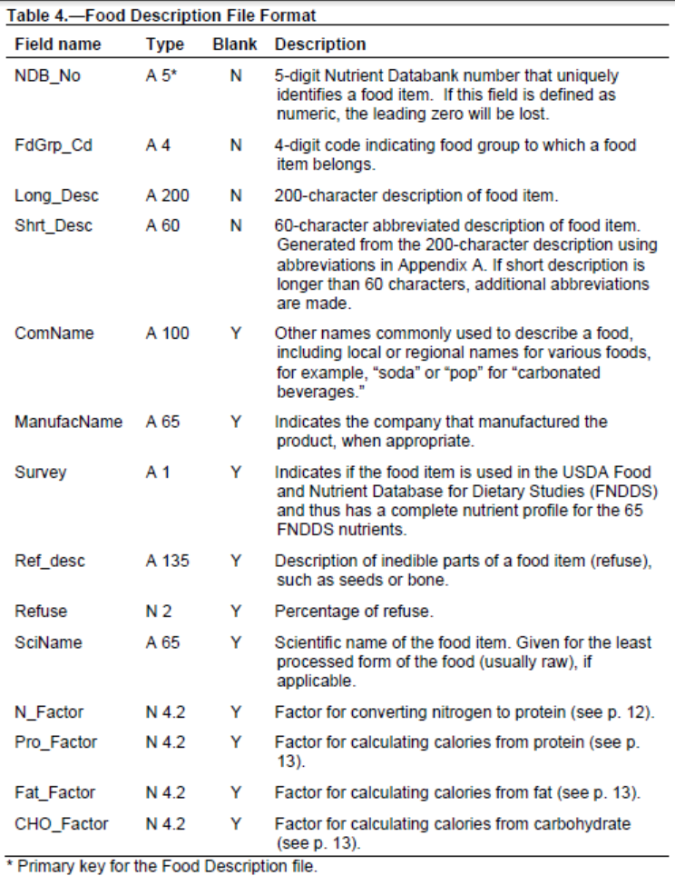

Slide 7
DEMO TIME!
Entity Framework code first

Slide 8
What We Learned
Code First is Simple
… in many cases it “just works”
For small projects this is great.
… trust me, on large projects it’s just as awesome!

Slide 9
Also Consider: Telerik Data Access
http://www.Telerik.com/data-access
Technical support
Automatically generate web services
Convert legacy / other ORMs to Data Access
Built-in support for multiple databases (SQL, SQL Azure, Oracle, MySQL, SQLite, PostgreSQL & more)
Very similar syntax to Entity Framework

Slide 10

Web API and REST
Entity Framework gives you easy access to your data
Repository pattern is nice (we’ll skip it today)
Web API is all about taking your data and exposing it via REST
OData is another option on top of Web API

Slide 11
DEMO TIME!
How Fast can you REST?

Slide 12
What We Learned
Web API is straightforward
Web API is testable (both unit and integration)
Web API has tons of helpers to make your life easy
OData layers on top of Web API
OData provides a standard contract for querying and modifying data that you would otherwise implement manually

Slide 13

Telerik, Kendo UI, and MVC
HTML Helpers and fluent configuration
Did you know how easy it is to support Single Page Apps?
Consider using the grid “easy button” by building them on the client (SPA-style)
See http://bit.ly/spa-os
Better together!

Slide 14
DEMO TIME!
the Grid (with Unicorns)

Slide 15
What We Learned
You can use MVC or Web API to serve data
You can shape the data and control the flow on the client side with JavaScript
Two steps to add unicorns to your project:
aspnetmvc-ajax at the client
DataSourceRequest (and result) on the server

Slide 16

Stop Killing Yourself over Forms!
Say “no” to recreating your model in 15 different places
Ask me about imperative vs. declarative
Don’t just tell the user what they did wrong. Keep them from doing it in the first place!
Kendo UI has the pixie dust you need …

Slide 17
DEMO TIME!
The Form (with More Unicorns)

Slide 18
What We Learned
Kendo can turn your data directly into a view model
Validation is straightforward
Annotations can transform input fields into fully functional Kendo UI controls

Slide 19
BONUS ROUND!
Inline Editing

Slide 20
What We Learned
Kendo plays really well with OData, too
There are just a few tweaks needed to “inform” the data source
You can literally create data-driven apps in hours (or even minutes)
Create a simple, out of the box solution
Or add in custom business rules, end points and logic
“It’s all good.”

Slide 21
Questions, anyone?
How’s My Driving?
http://bit.ly/next-likness-1
Jeremy Likness
@JeremyLikness
http://bit.ly/coderblog
http://github.com/jeremylikness/telerikNEXT2015/

